Slide 1


Slide 2
Objectives
Review the new guidelines
Discuss the major changes and evidence behind them
Learning stations
Practice codes

Slide 3
ACLS
October 2015
  Heart and Stroke Foundation Canada published the updated ACLS guidelines.
  Every 5 years
  No major ACLS changes since 2005

Slide 4
Why ACLS
Spontaneous cardiac arrest is the leading cause of death in North America
VF seen on first assessment of 40%
  Likely more have VF initially but have deteriorated by time of first contact
VF is a potentially treatable problem

Slide 5
Key Points
  CPR doesn’t have to be perfect
  Fast action – any action
  911 dispatch compression only CPR

Slide 6
Signs of Life
Unchanged from 2010 recommendations
Pulse
Breathing
Moving/Talking

Slide 7
Emphasis on “good quality” CPR
Push hard (5 cm)
  Now max depth (6cm)
Push fast (100/min)
  Now max rate (120/min)
Allow for recoil
Minimize interruptions

Slide 8
Emphasis on “good quality” CPR
Breathing
  30:2
    Better than 15:2
  One every 6 seconds (10/min) with Advanced airway
    Simplified

Slide 9
General Public
Good, Better, Best.
Good –call 9-1-1 and follow the dispatcher’s directions
Better - learn hands-only CPR and defibrillation
Best – learn CPR that includes rescue breathing and defibrillation

Slide 10
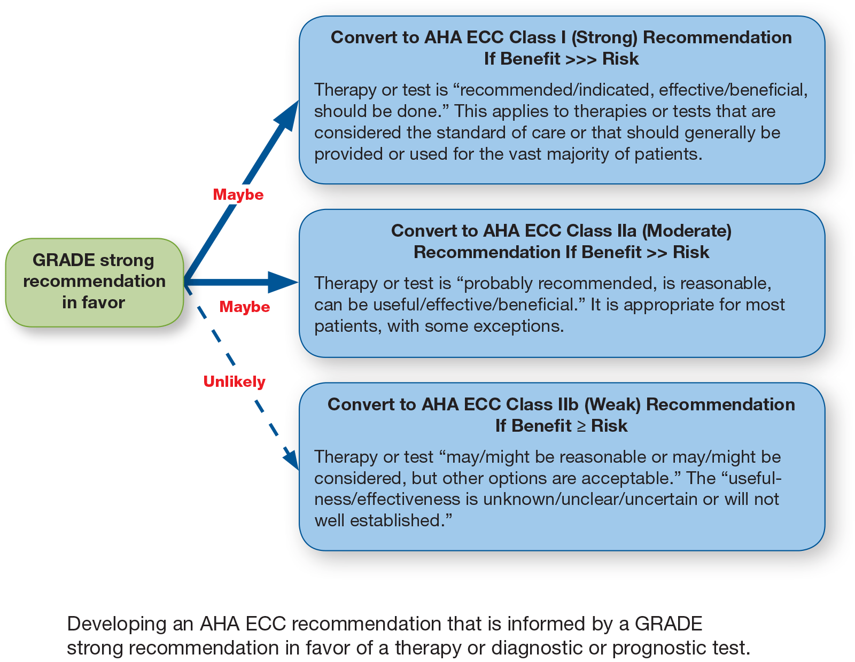

Slide 11
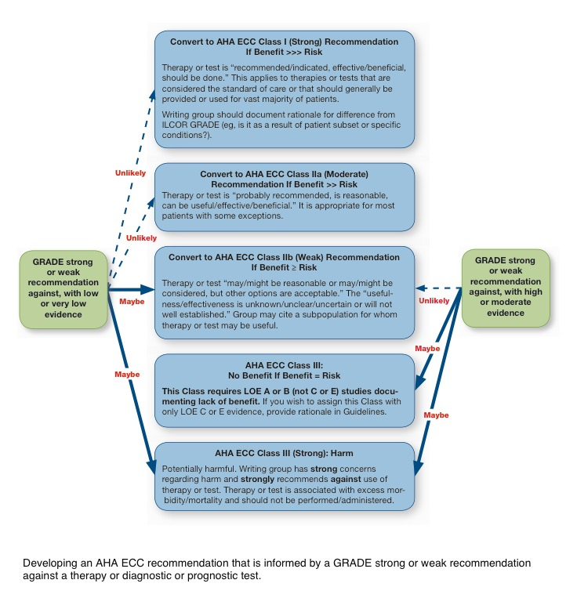

Slide 12
Delayed ventilation
For witnessed OHCA with a shockable rhythm, it may be reasonable for EMS systems with priority-based, multitiered response to delay positive-pressure ventilation (PPV) by using a strategy of up to 3 cycles of 200 continuous compressions with passive oxygen insufflation and airway adjuncts.

Slide 13
Evidence for CPR
Good News:
  Immediate CPR post arrest increases survival by 2-3 x
    Survival greatest if CPR started immediately with early defibrillation
Bad News:
  Survival decreases 7-10%/minute without CPR
  Survival decreases 3-4%/minute with CPR

Slide 14
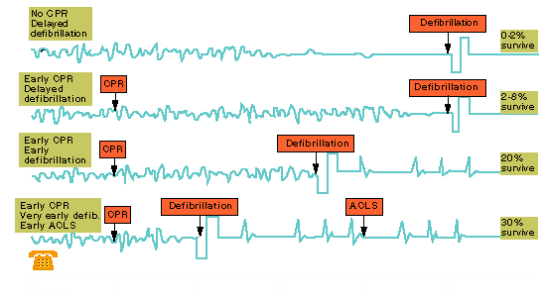
CPR’s Role

Slide 15
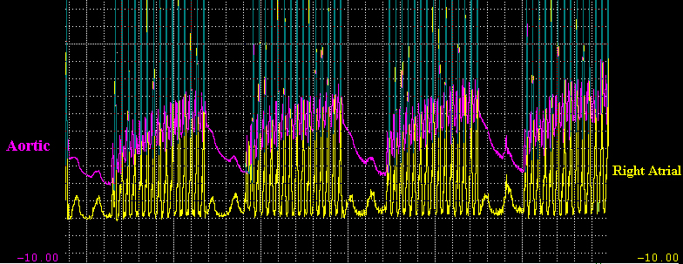
CPR’s Role
Rational - 30:2
  Increased number of compressions improves perfusion (CPP & CAPP)
  Decreases hyperventilation
  Minimizes interruption to compressions

Slide 16
CPR
Fatigue is a factor in rate and depth of compression
  Rotate often (but don’t forget to minimize interruptions in CPR)

Slide 17
CPR’s Role
Provides blood flow to brain and myocardium
Prolongs VF rhythm
Increases likelihood that defibrillation will be successful

Slide 18
CPR Techniques
ACD CPR
  There is insufficient evidence to recommend for or against the routine use of ACD-CPR. ACD-CPR may be considered for use when providers are adequately trained and monitored. (Class IIb, LOE B)

Slide 19
CPR Techniques
Impedance Threshold Device
  The routine use of the ITD as an adjunct during conventional CPR is not recommended. (Class III: No Benefit, LOE A)

Slide 20
CPR Techniques
Mechanical devices for chest compressions versus manual chest compressions
  Does not demonstrate a benefit. Manual chest compressions remain the standard (Class IIb, LOE B-R)
  May use where compressions may be challenging or dangerous (eg, prolonged CPR, during hypothemiac CA, moving ambulance, angiography suite, etc…) provided that rescuers strictly limit interruptions in CPR during deployment and removal of the devices. (Class IIb, LOE C-EO)
ECPR
  Not recommended (Class IIb, LOE C-LD)

Slide 21
Defibrillation
Stuns the myocardium, terminates abnormal rhythm potentially allowing normal conduction to resume

Slide 22
CPR done, given a shock … now what?
Do not check the rhythm
Do not check the pulse
Do not stop at Go and collect $200
Resume CPR (30:2) for another 2 minute cycle before checking

Slide 23
Post Shock CPR
No pulse check / rhythm check post shock
Immediate return to CPR
2 minute cycle
Class IIb

Slide 24
Pre Shock CPR
Post rhythm analysis +/- pulse check - Immediately resume CPR prior to shock
Ideally up to “Ready to Shock”

Slide 25
Is it your lucky day?
Who is most likely to survive?
  Age < 75
  Early bystander CPR
  Early defibrillation

Slide 26
Vasopressors and Steroids
Epinephrine 1mg IV q 3-5 min (works out to being every other cycle)
Vasopressin (out)
Steroids – maybe in the future
, “…further studies are needed before recommending the routine use of this therapeutic strategy.”
(Class IIb, LOE C-LD)
For patients with OHCA, use of steroids during CPR is of uncertain benefit. (Class IIb, LOE C-LD)

Slide 27
Antiarrithmics
Amiodarone 300mg IV
  Follow with a second dose of 150mg
  Consider magnesium 2g IV if torsades

Slide 28
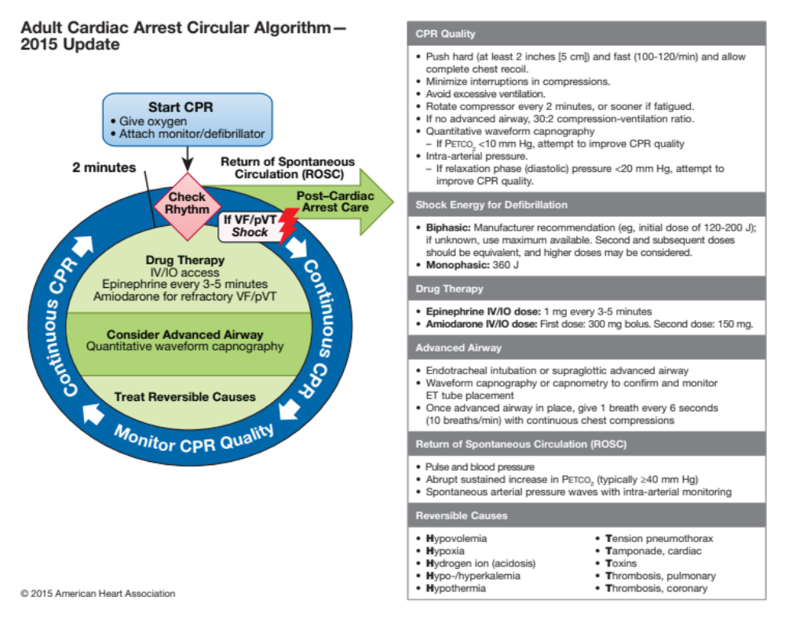

Slide 29
PEA & Asystole
CPR
Vasopressor
  Epinephrine
Look for underlying causes (H’s & T’s)

Slide 30
The H’s and T’s
Hypothermia
Hypoxia
Hypovolemia
Hyper/hypokalemia
Hydrogen ions (acidosis)
Hypoglycemia
Tablets
Tension pneumothorax
Tamponade
Thrombus (AMI)
Thrombus (PE)

Slide 31
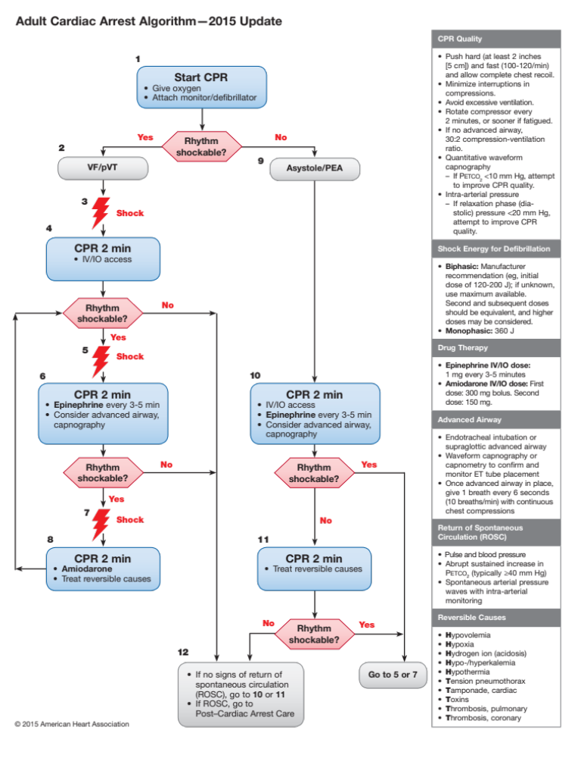

Slide 32
Bradycardias
Stable vs unstable (signs/symptoms of poor perfusion)
Atropine 0.5mg
Pacing (transcutaneous or transvenous)
Consider dopamine/epi infusion

Slide 33
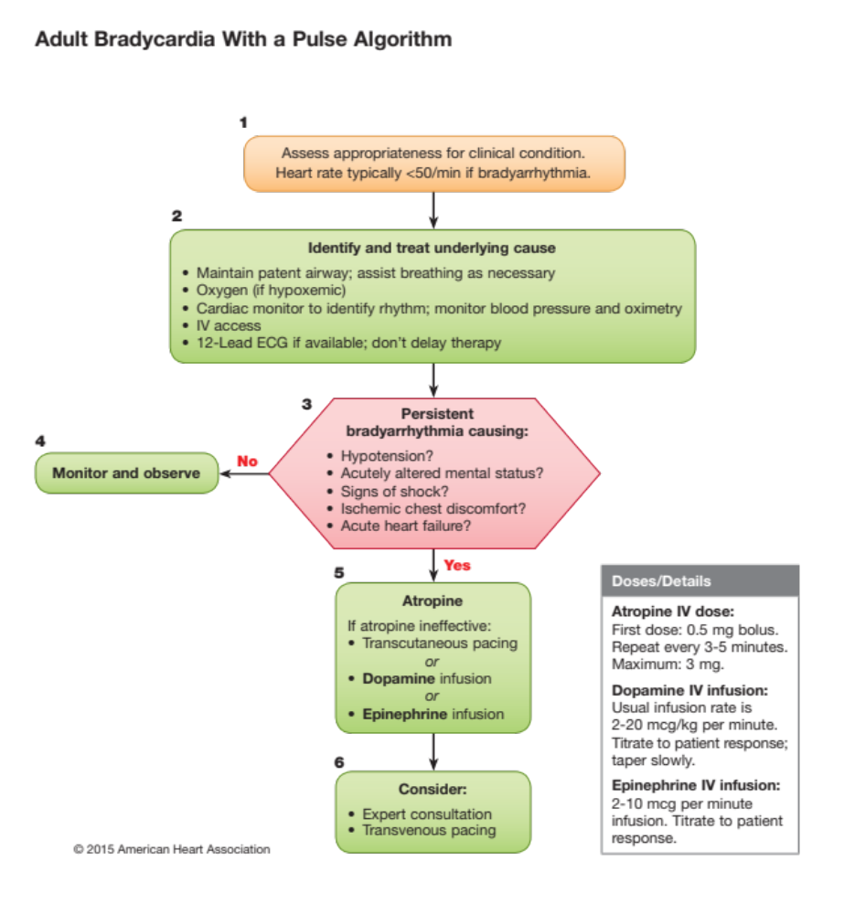

Slide 34
Tachycardias
Stable vs unstable
Wide vs narrow QRS
Regular or irregular
Consider physiologic reasons (eg. hypovolemia)

Slide 35
Atrial Fibrillation
Rate control
Anticoagulation
Rhythm control

Slide 36
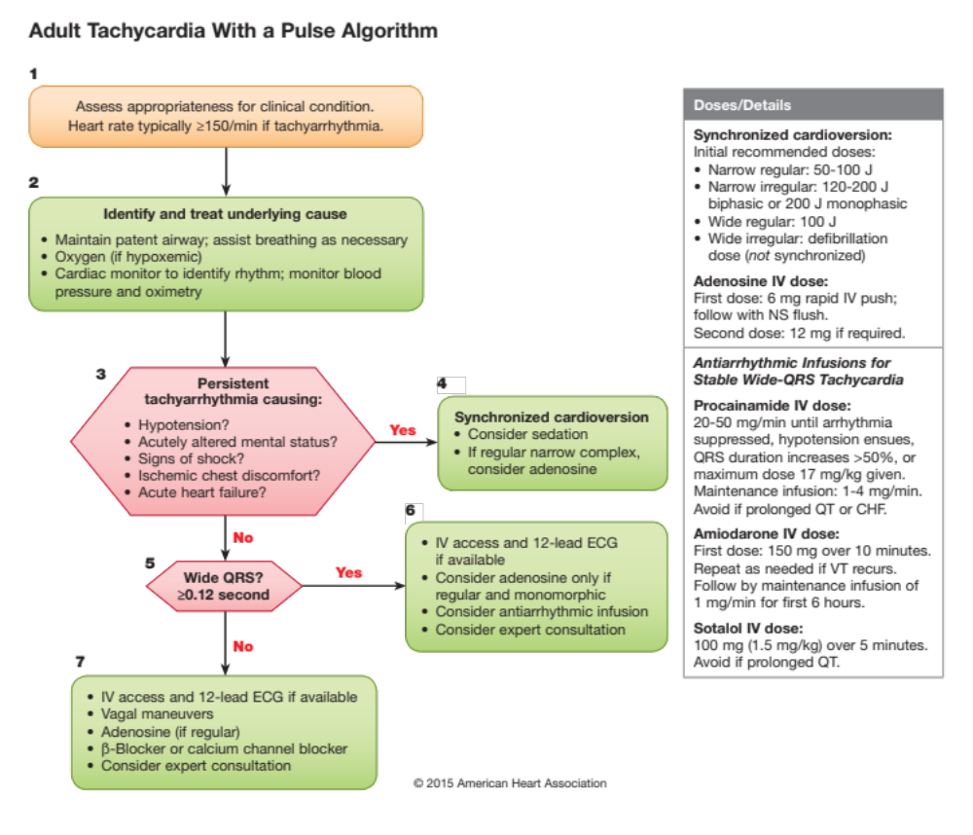

Slide 37
ACS
Identification
MONA … only the ASA saves lives!
O₂ for SpO₂ <94%
Role of thrombolytics (STEMI)
Role of PCI (contraindications to, or failed thrombolysis, shock, door to needle time < 90 minutes)

Slide 38
CHF
Decrease preload, decrease afterload, improve pump function
Improve oxygenation / decrease work of breathing
Look for, and correct, underlying cause

Slide 39
Schedule
Day 1
  Tachycardias
  Bradycardias
  BLS/CPR review
  PEA/asystole
  VF/pulseless VT
  A Fib
  Airway
Day 2
  CHF
  ACS
  Practice, practice, practice!
  Practical exam

Slide 40
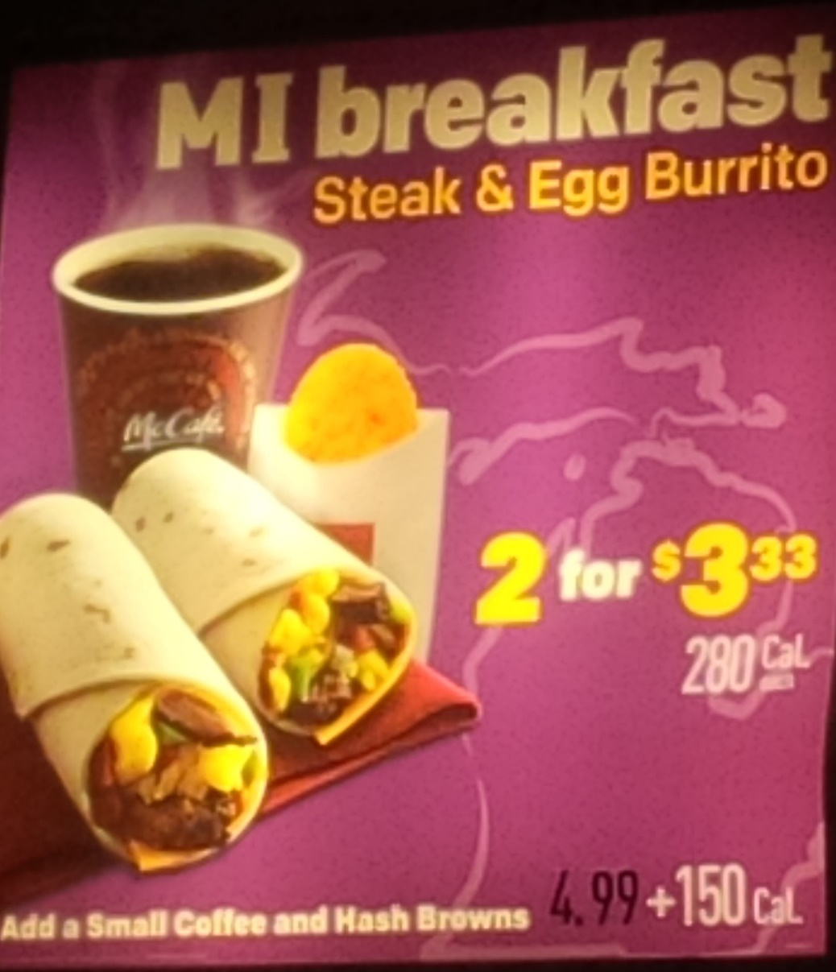
Questions?

Slide 41

Have fun!

